Slide 1
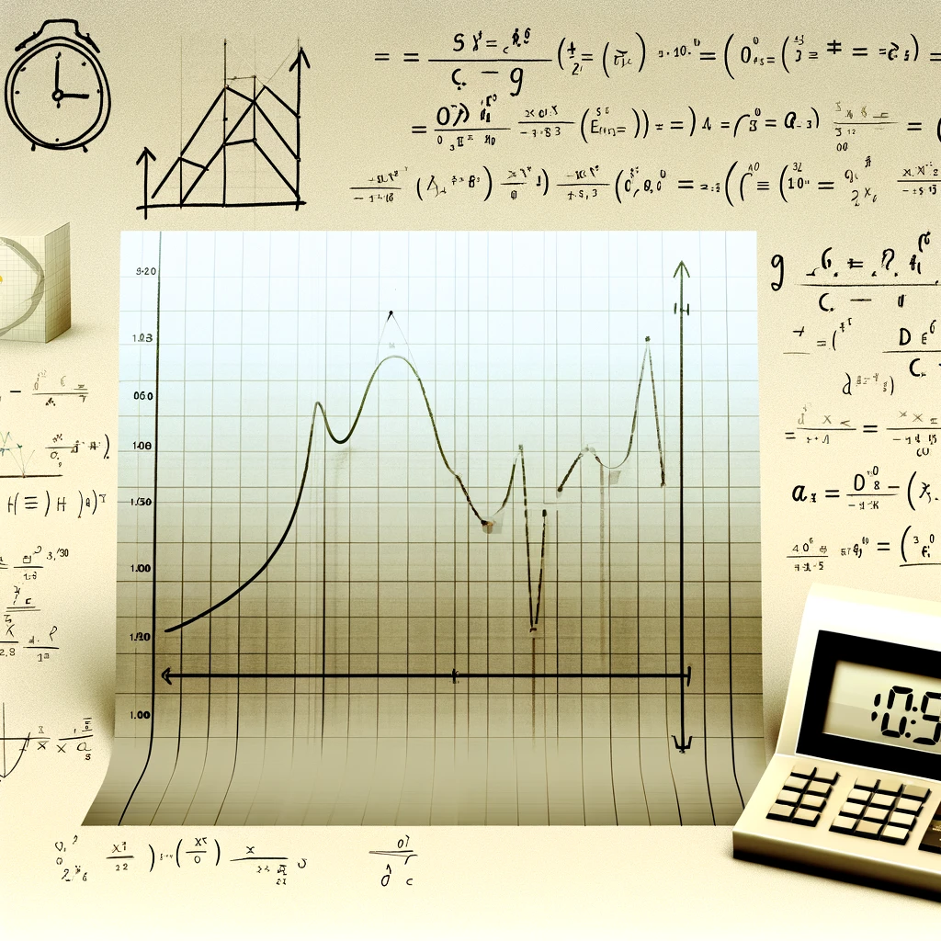
PREDICTING GOOGLE TRENDS USING ADS SPENDING
A Comparative study using SARIMA, SARIMAX, Prophet models.
- Priyanka Bhosale

Slide 2

Introduction
Objective: Predict Google Trends data for Home Depot to assess how ad spending influences online search interest, aiding in marketing and sales forecasting.
Background: Leveraging the link between advertising and online search behavior in the digital era enables companies to hone their marketing strategies, budget wisely, and enhance their online footprint. This insight is key for Home Depot to boost consumer interest and sales.
Data Sources: The project uses Google Trends Data and Home Depot's Ad Spending Data to monitor brand interest shifts and advertising investment over time. The aim is to create a model that demonstrates how ad spending affects Google Trends scores, offering insights into the efficacy of Home Depot's advertising campaigns in driving search interest. This analysis intends to guide businesses in evaluating their advertising impact.

Slide 3
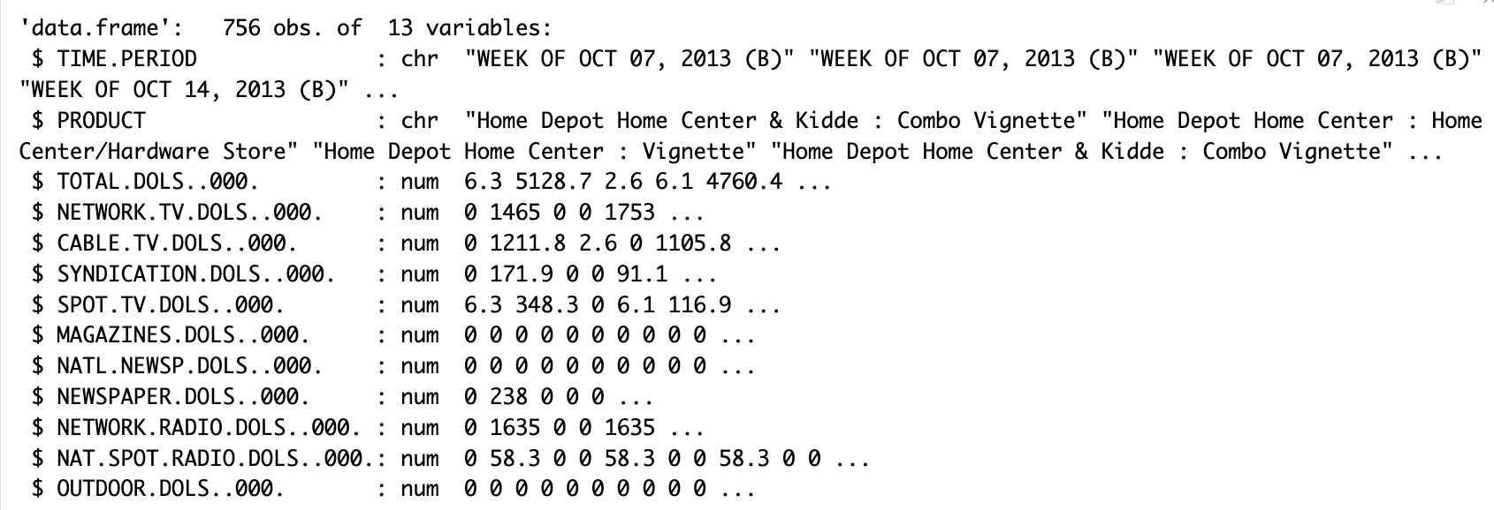
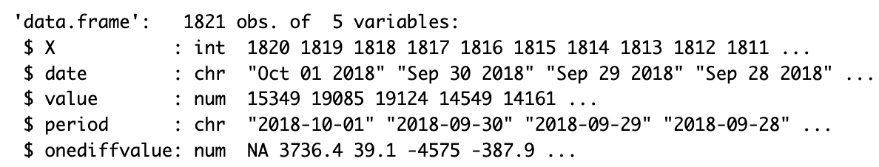
Dataset Summary
Google Trends Dataset
Home Depot Ad Spending Dataset​

Slide 4
Data Exploration and Preprocessing
Google Trends Data:
Original Structure: The dataset initially had 1821 rows and 5 columns. The key fields include the date of the search query and the corresponding Google Trends value for Home Depot.
Preprocessing Steps:
Missing Values: Identified and removed one row with missing values, reducing the dataset to 1820 rows.
Date Conversion: Converted the 'date' column from character to Date datatype for proper time series analysis.
Column Renaming: Renamed the first column to 'id' for clarity and dropped the 'period' column as it was redundant, containing the same data as the 'date' column.
Type Conversion: Changed 'value' and 'onediffvalue' columns to numeric types for analysis.
Home Depot Ad Spending Data:
Original Structure: Comprised of 756 rows and 13 columns, detailing Home Depot's weekly ad spending across various media.
Preprocessing Steps:
Missing Values: Checked and confirmed there were no missing values.
Column Renaming: Simplified column names for better readability (e.g., renamed 'DOLS' to 'Dollars') and removed unnecessary text from column names.
Date Format: Transformed the 'TIME_PERIOD' column from a text to a Date datatype, removing unnecessary prefixes and formatting dates consistently.

Slide 5
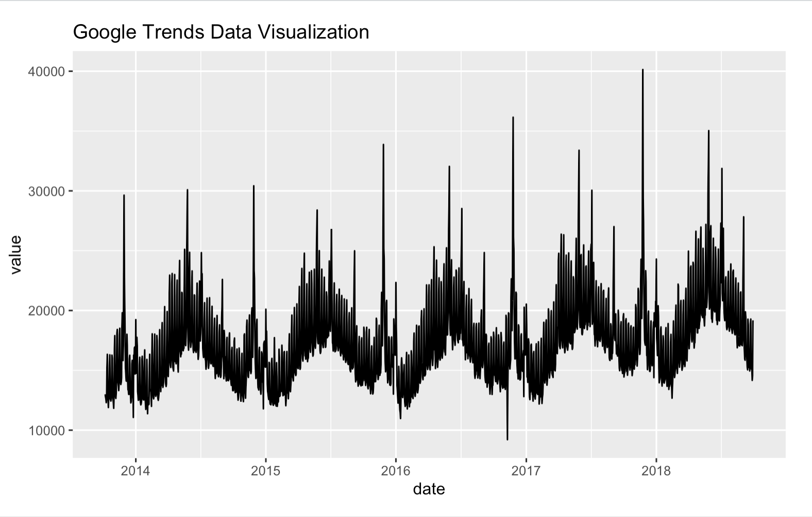
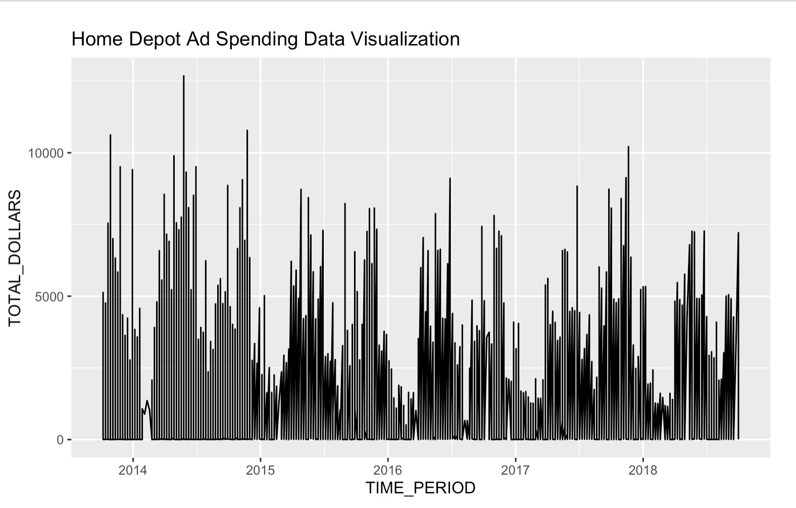
Initial Insights
Google Trends Data:
Trends: Preliminary examination shows fluctuations in search interest over time, possibly aligning with specific marketing campaigns or seasonal shopping periods.
Seasonal Patterns: Need to further investigate potential seasonal patterns, such as increased interest during holiday seasons or specific sales events.
Variance: Also show increasing variance.
Home Depot Ad Spending Data:
Spending Trends: Initial analysis suggests variations in advertising expenditure across different times of the year, which could correlate with Home Depot’s strategic marketing initiatives.
Seasonality: Can observe seasonal patterns over years

Slide 6
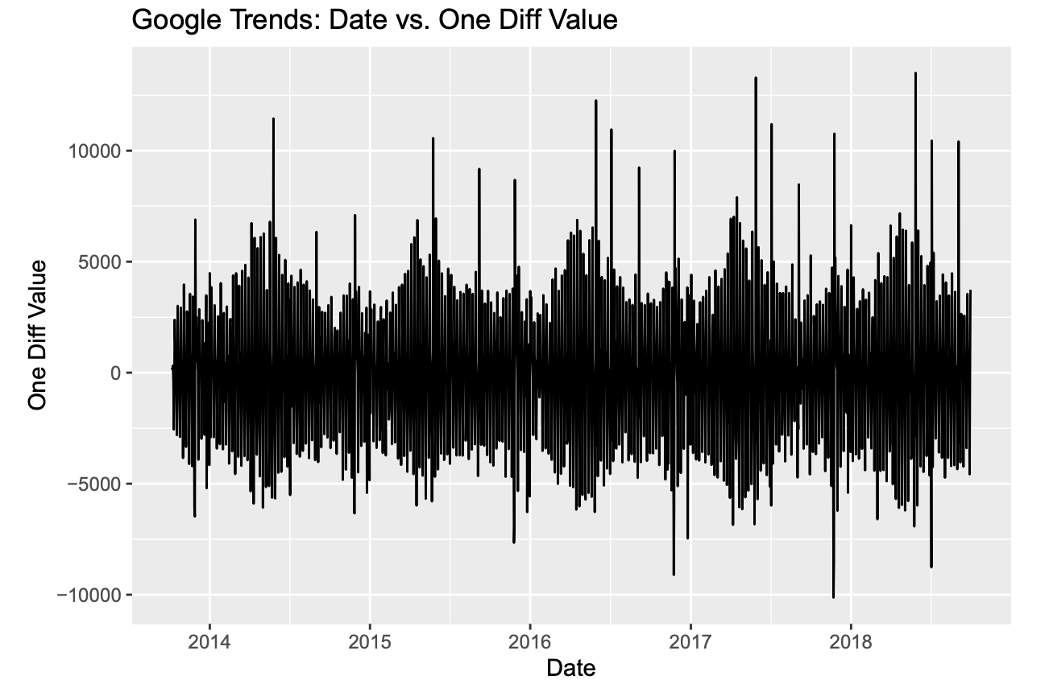
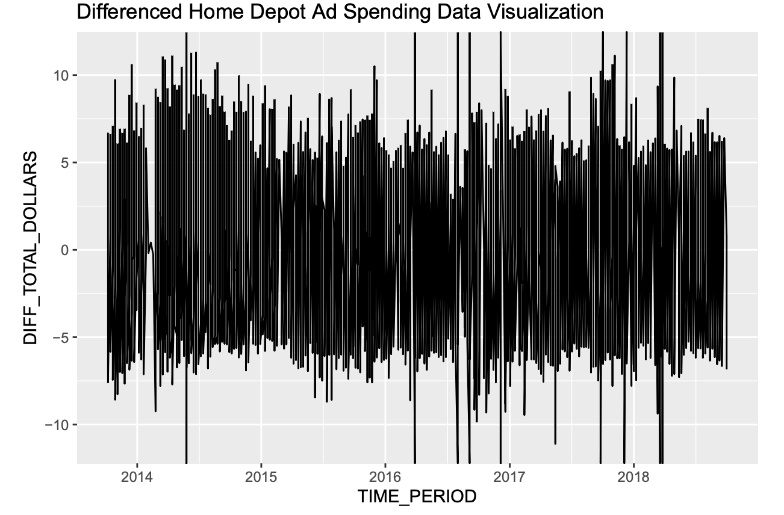
Performed differencing to make the time series stationary
Note : Edited slide with new code changes
Google Trends Data:
Date vs One Difference Value: To address significant variance in the data, we difference it. The "onediffvalue" column in the Google Trends dataset contains this differenced data. We will now plot the graph for "onediffvalue"
This plot reveals the first-order differenced values, stabilizing the pattern around a constant mean by removing trends and seasonality, thereby making the series stationary.
Home Depot Ad Spending Data:
First-order differencing for TOTAL_DOLLARS: After performed differencing, this plot shows a more stable pattern around a constant mean, indicating that the differencing has removed the trend and seasonality from the original data

Slide 7
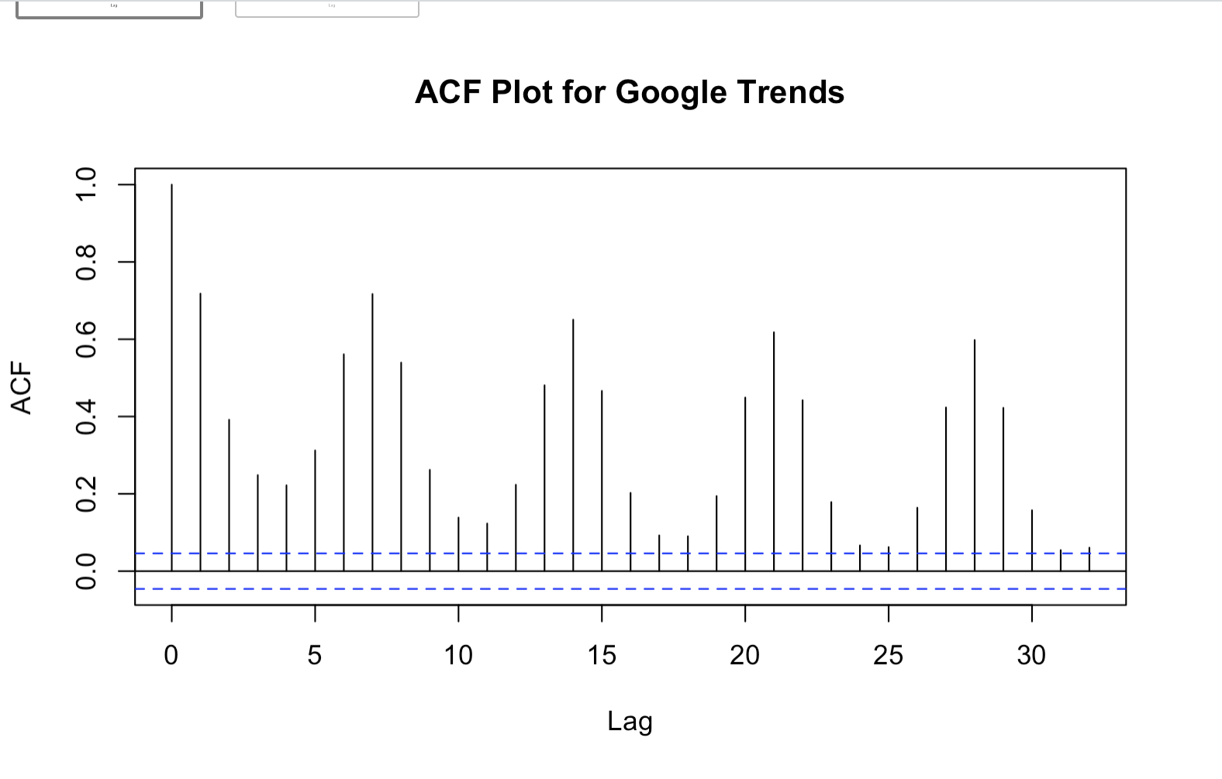
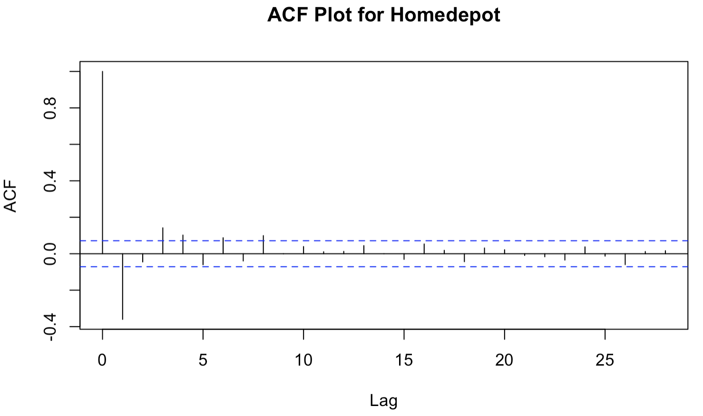
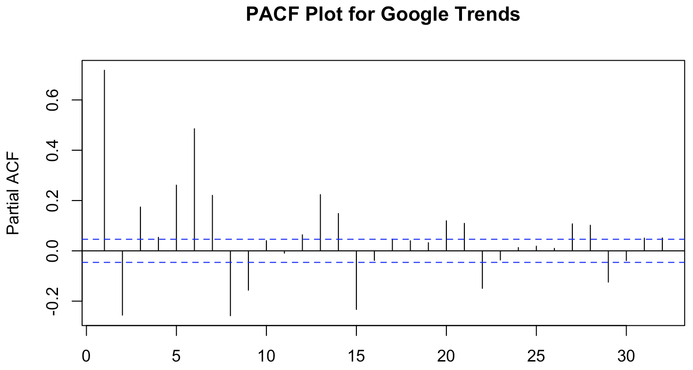
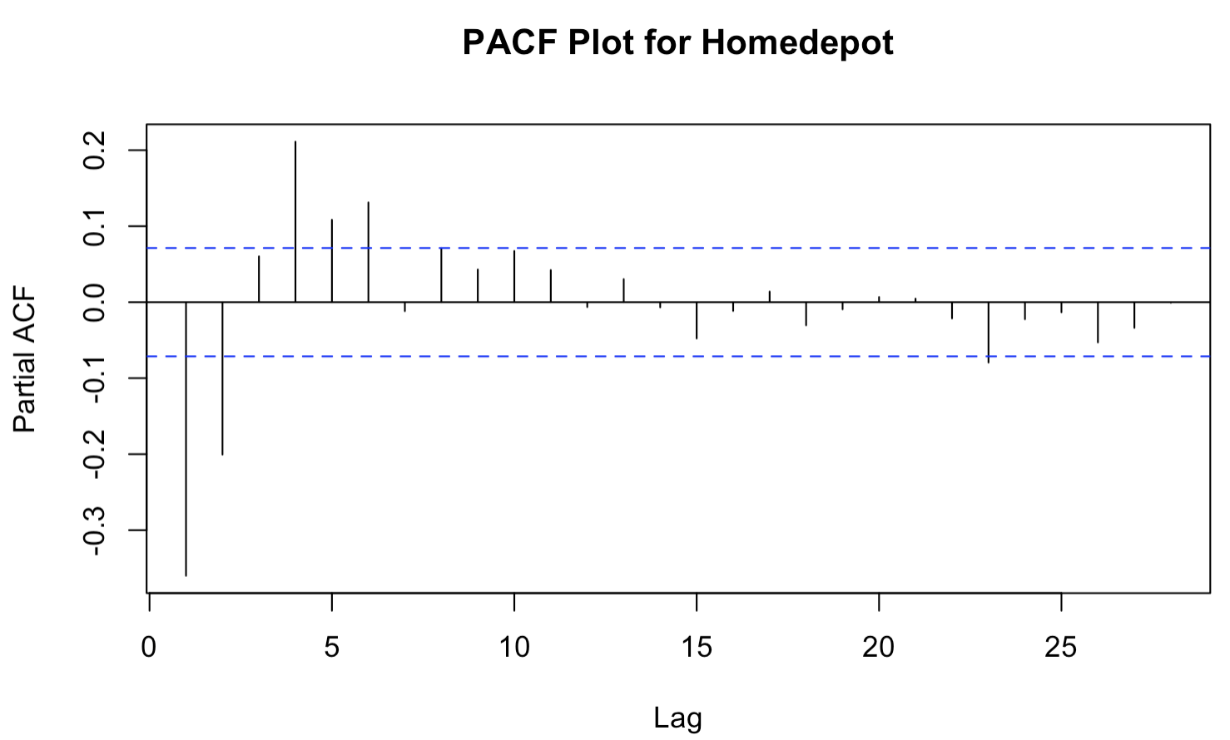
ACF vs PACF
ACF and PACF Plots for Google Trends (Original Data):
ACF Plot: The plot shows significant autocorrelation at multiple lags. This indicates that the data is likely non-stationary and may have a seasonal pattern
PACF Plot: The significant spikes in the PACF plot at the initial lags that cut off after a point suggest an AR process might be present.
ACF and PACF Plots for Home Depot Data (Original Data):
ACF Plot: The ACF plot displays a gradual decay, which is typical of an AR process. There aren't regular, pronounced spikes that would suggest seasonality.
PACF Plot: The PACF plot shows a significant spike at lag 1 and then cuts off, which is indicative of an AR(1) process

Slide 8
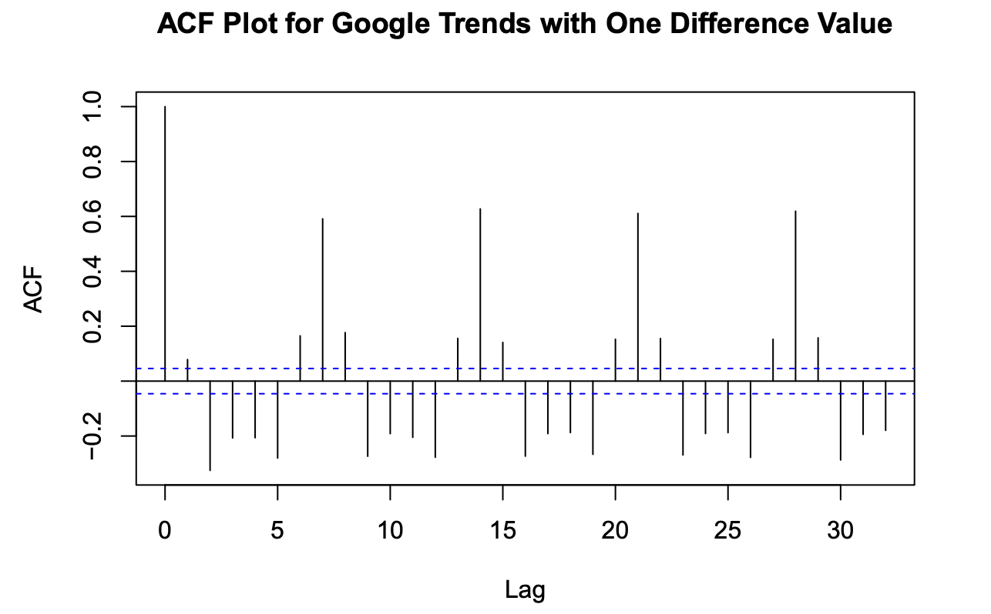
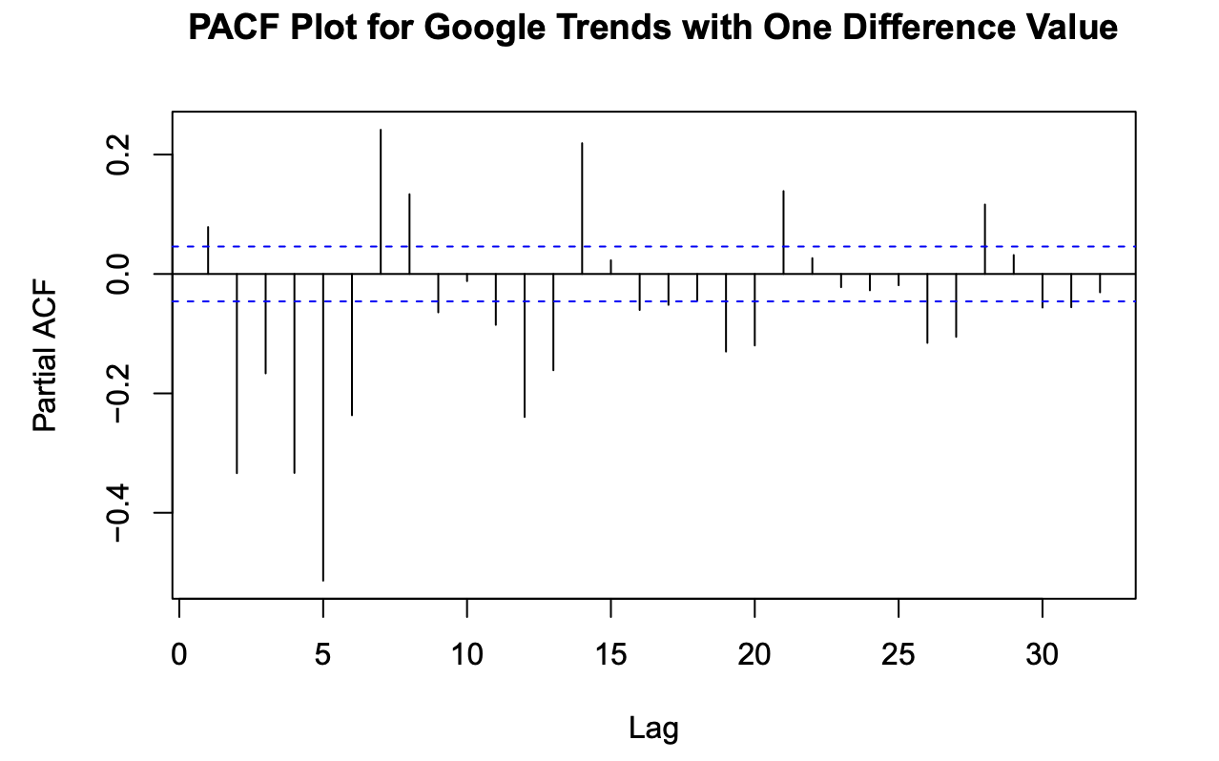
ACF VS PACF for Google Trends Differenced Data
Note : Edited slide with new code changes
The ACF plot shows a significant spike at lag 1, suggesting the presence of a first-order moving average (MA) component in the time series.
The PACF plot shows a decaying pattern, indicating the potential presence of an autoregressive (AR) component. These plots help identify the appropriate orders for the ARIMA/SARIMA models.

Slide 9
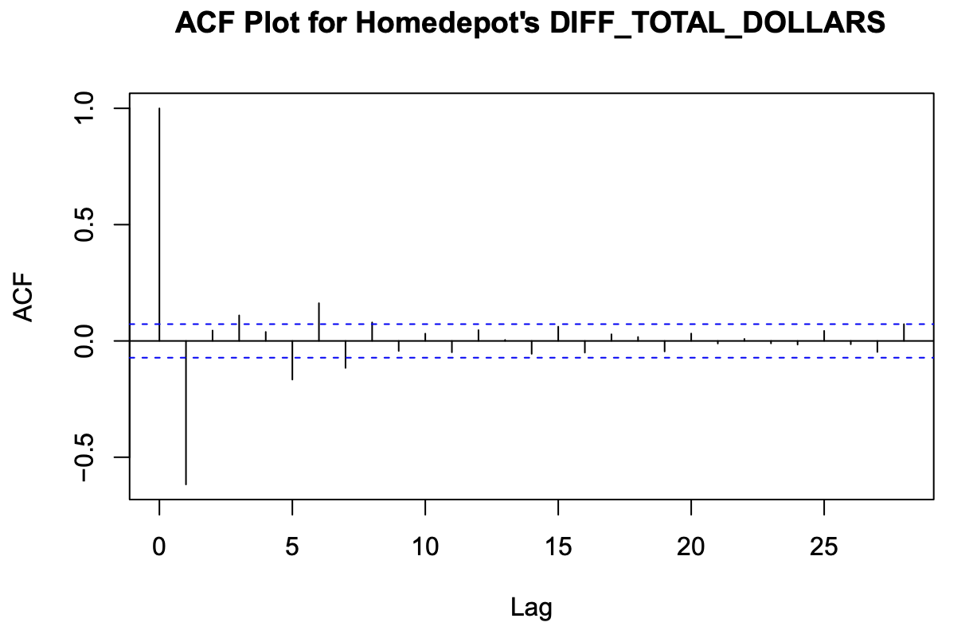
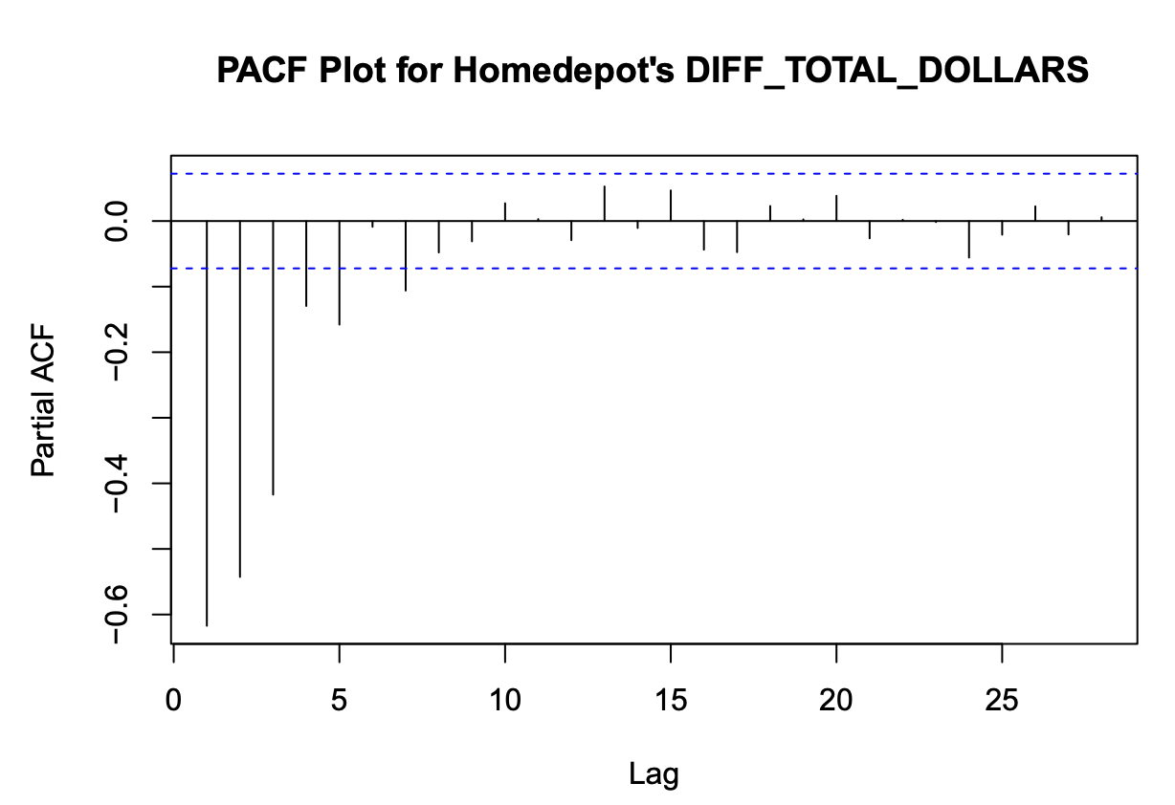
ACF vs PACF for HomeDepot Adspend Differenced data:
Note : Edited slide with new code changes
The PACF plot shows a decaying pattern, indicating the potential presence of an autoregressive (AR) component. These plots help identify the appropriate orders for the ARIMA/SARIMA models for the advertisement spending data.
ACF plot shows a significant spike at lag 1, suggesting the presence of a first-order moving average (MA) component in the time series

Slide 10

Merging Datasets
Both the datasets have been merged on the common date column, missing values were removed.
Performed Analysis on Correlation of Google Trends over time and Ad Spending over time.
Merged data has been differenced and the data has been split into 80, 20 to fit the models.
Where 80% is the train data and 20% is the test data.

Slide 11
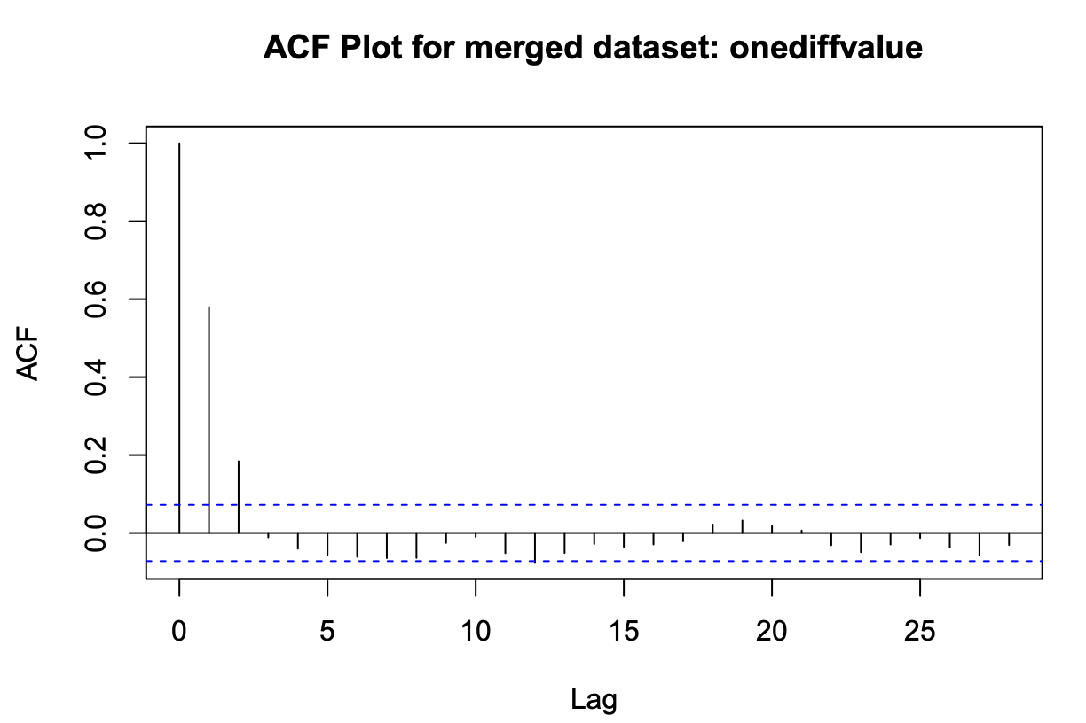
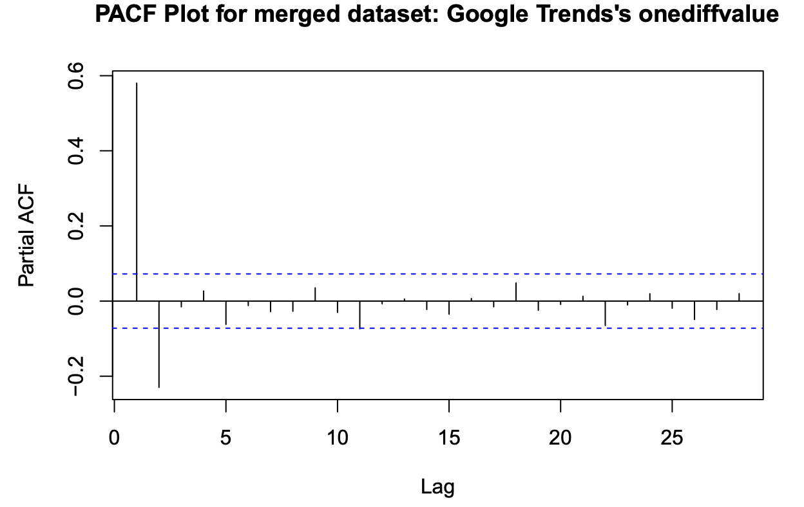
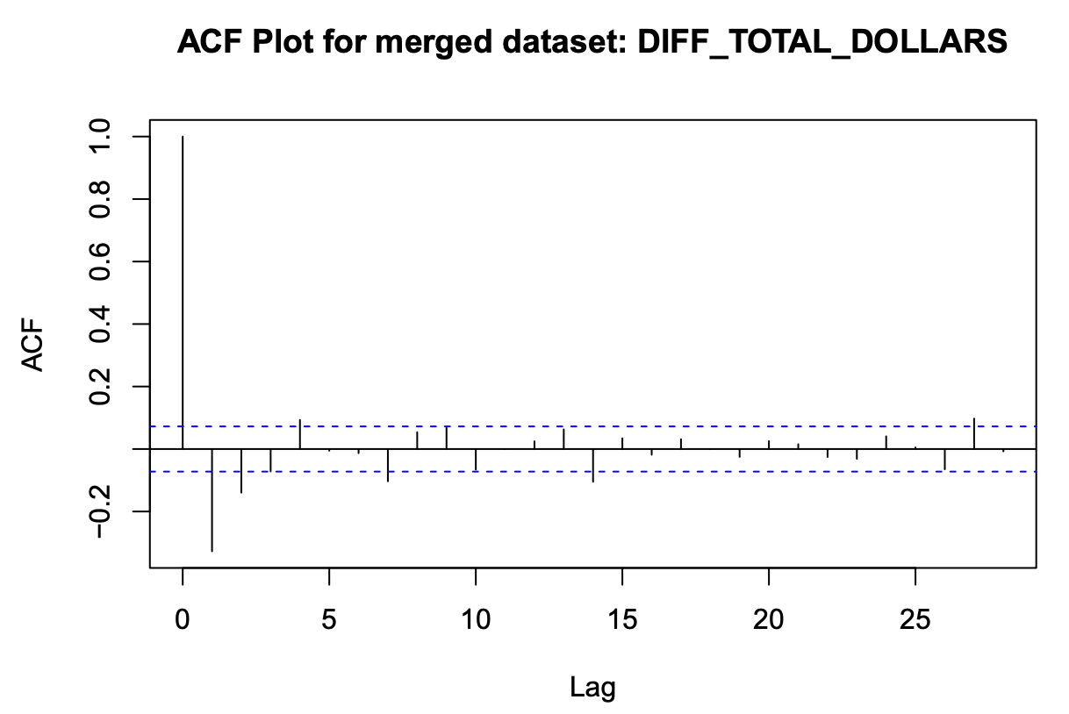
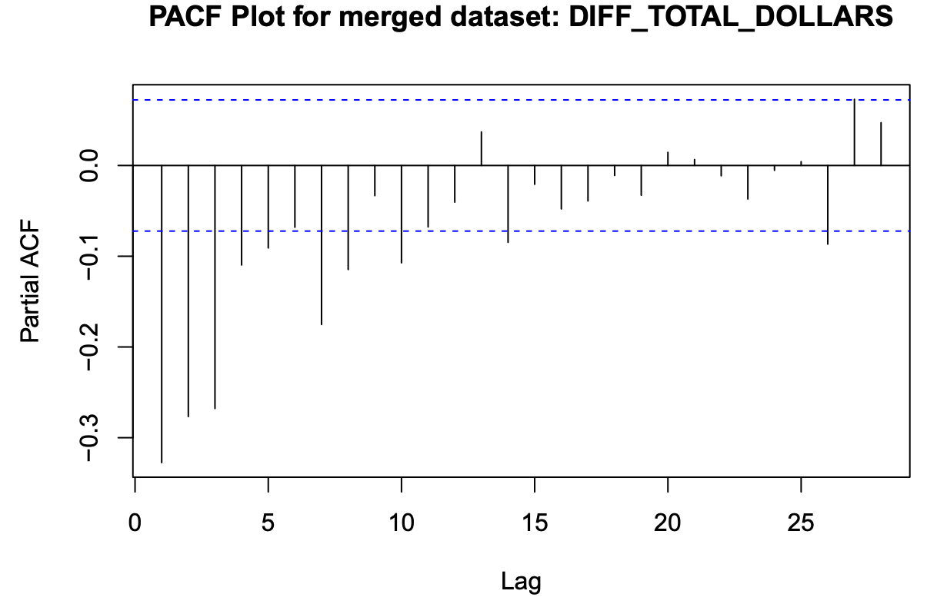
ACF vs PACF for Merged Data
Note : Plotted with new code changes

Slide 12
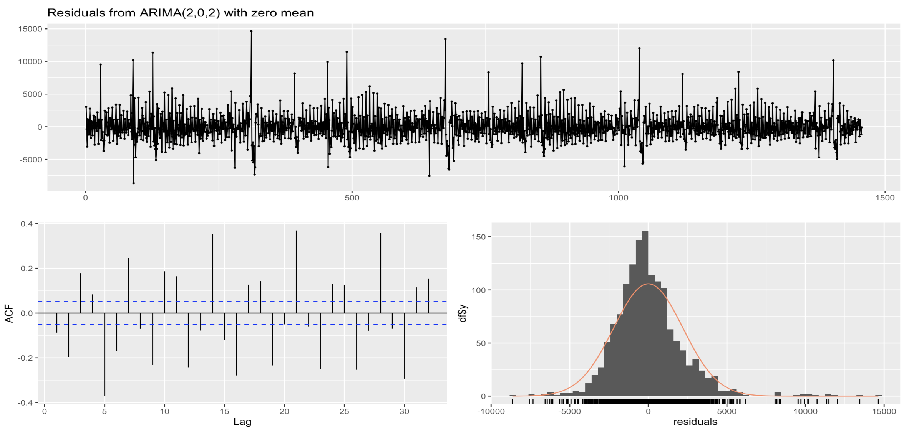
SARIMA
Presentation day slide
Fitting the SARIMA Model
Fitted an ARIMA(2,0,2) model to the differenced training data, which means the model uses two autoregressive terms and two moving average terms.
Model Diagnostics
Residuals: The Ljung-Box test results, with a Q* statistic of 594.71 and a p-value less than 2.2e-16, indicate that there is very strong evidence against the null hypothesis of no autocorrelation in the residuals. This could suggest that the model may not be capturing all aspects of the data's structure.
Error Metrics: The training set error metrics, including RMSE (Root Mean Square Error) of 2204.434 and MAE (Mean Absolute Error) of 1573.005, provide a measure of the average magnitude of the errors in the predictions.
Mean Squared Prediction Error (MSPE)
MSPE: The Mean Squared Prediction Error (MSPE) for the model is reported to be approximately 6043255.

Slide 13
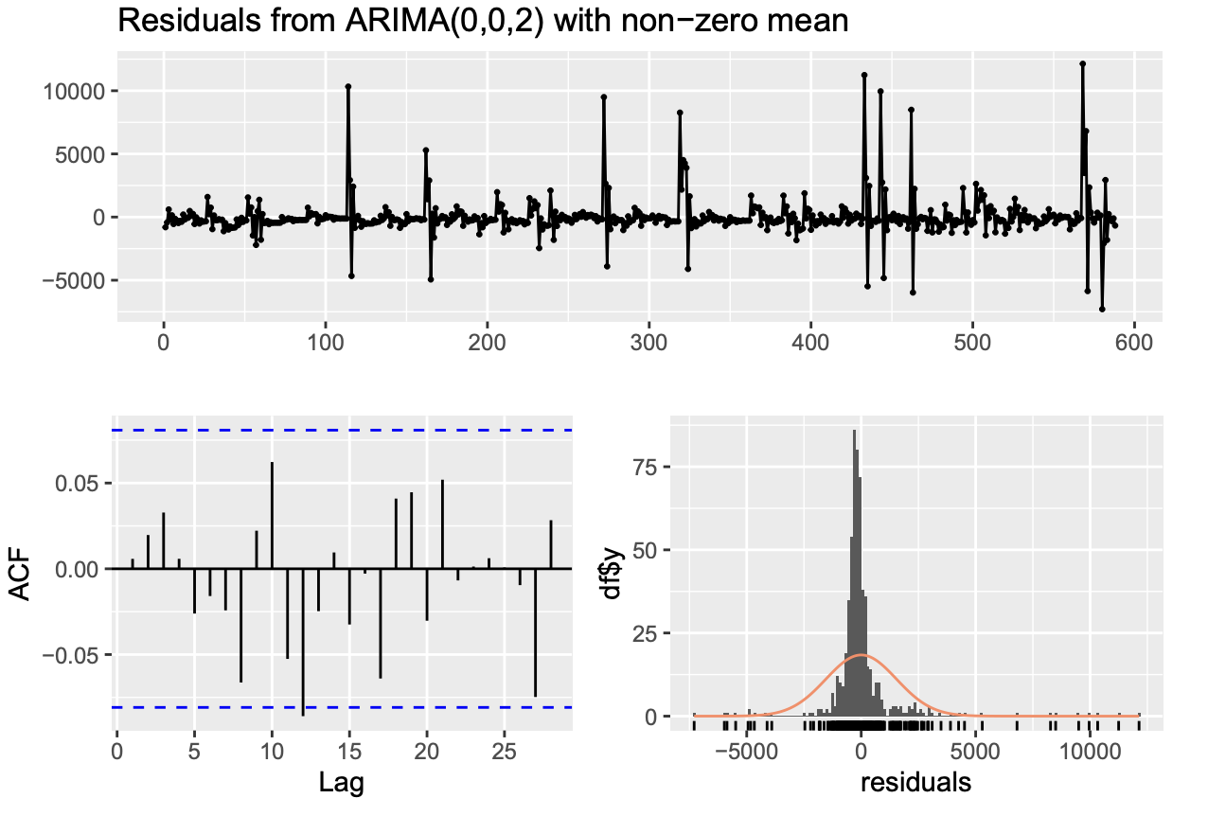
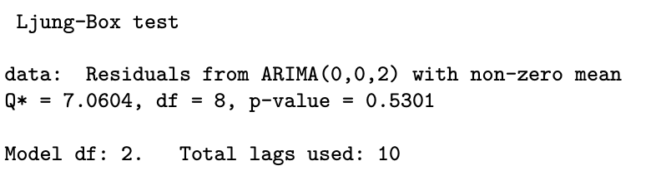
SARIMA Model without additional variables
Edited slide with new code changes
We use auto.arima() to train the model. It correctly identifies the model to be a (0,0,2) model that matches well with the ACF and PACF plots mentioned above for the merged dataset’s onediffvalue.

Slide 14
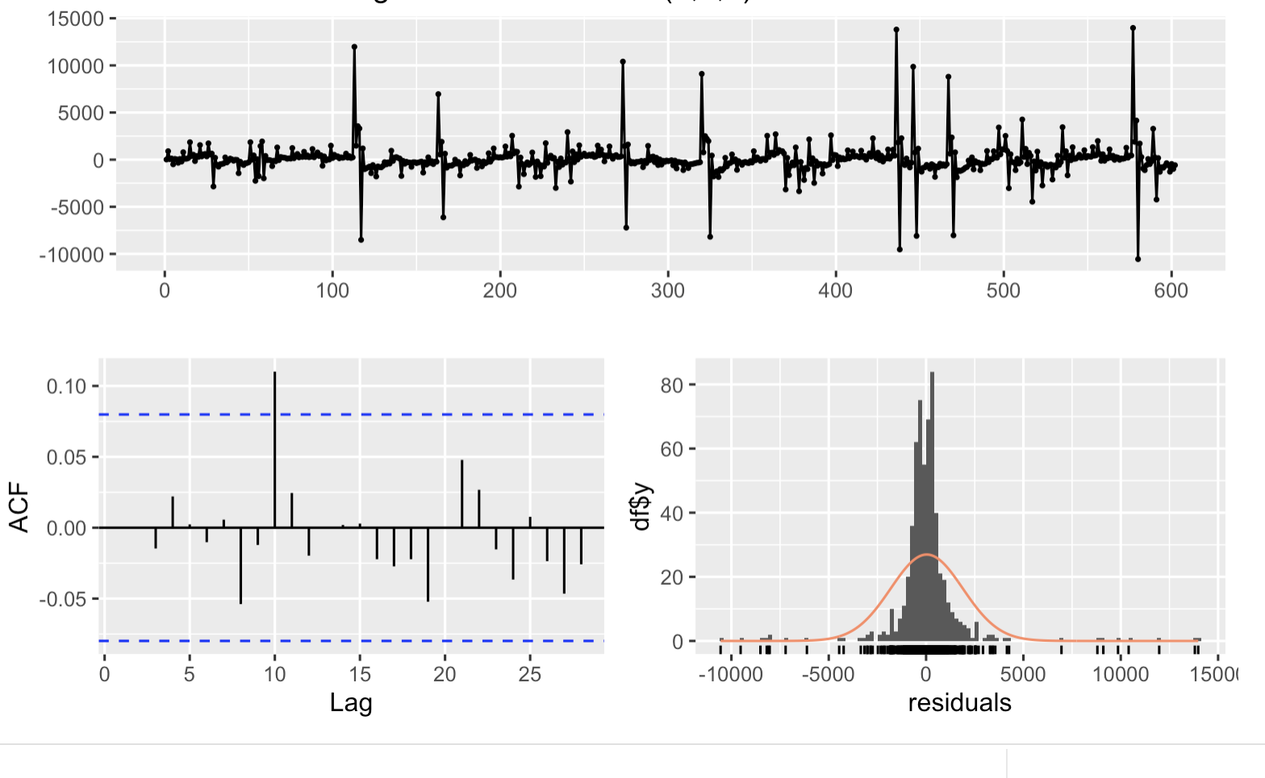
SARIMAX
Presentation day slide
SARIMAX model Fitting results :
The SARIMAX model includes an ARIMA(1,1,2) error structure with 'TOTAL_DOLLARS' as an external regressor. The model fitting results show that the selected ARIMA orders are relatively low, indicating a potentially simple autoregressive-moving-average process, but modified by the inclusion of exogenous information provided by the 'TOTAL_DOLLARS' variable.
The Ljung-Box test yields a p-value of 0.131, indicating that there is no significant autocorrelation left in the residuals at a 5% significance level. This is another indicator of a well-fitting model.
The Mean Squared Prediction Error (MSPE) is reported to be 14,341,220.
Model Diagnostics:
The residuals plot indicates fluctuations around zero without obvious patterns, which suggests that the model has captured much of the time series structure.
The ACF plot does not show significant correlations at various lags, meaning that there is little autocorrelation in the residuals. This is a good sign and implies that the model is capturing the time series dependencies effectively.
In conclusion, the diagnostics for the SARIMAX model suggest that it is performing well in capturing the time series structure and the influence of external ad spending, but we should also consider the MSPE in the context of other models to determine the best overall predictive performance.

Slide 15
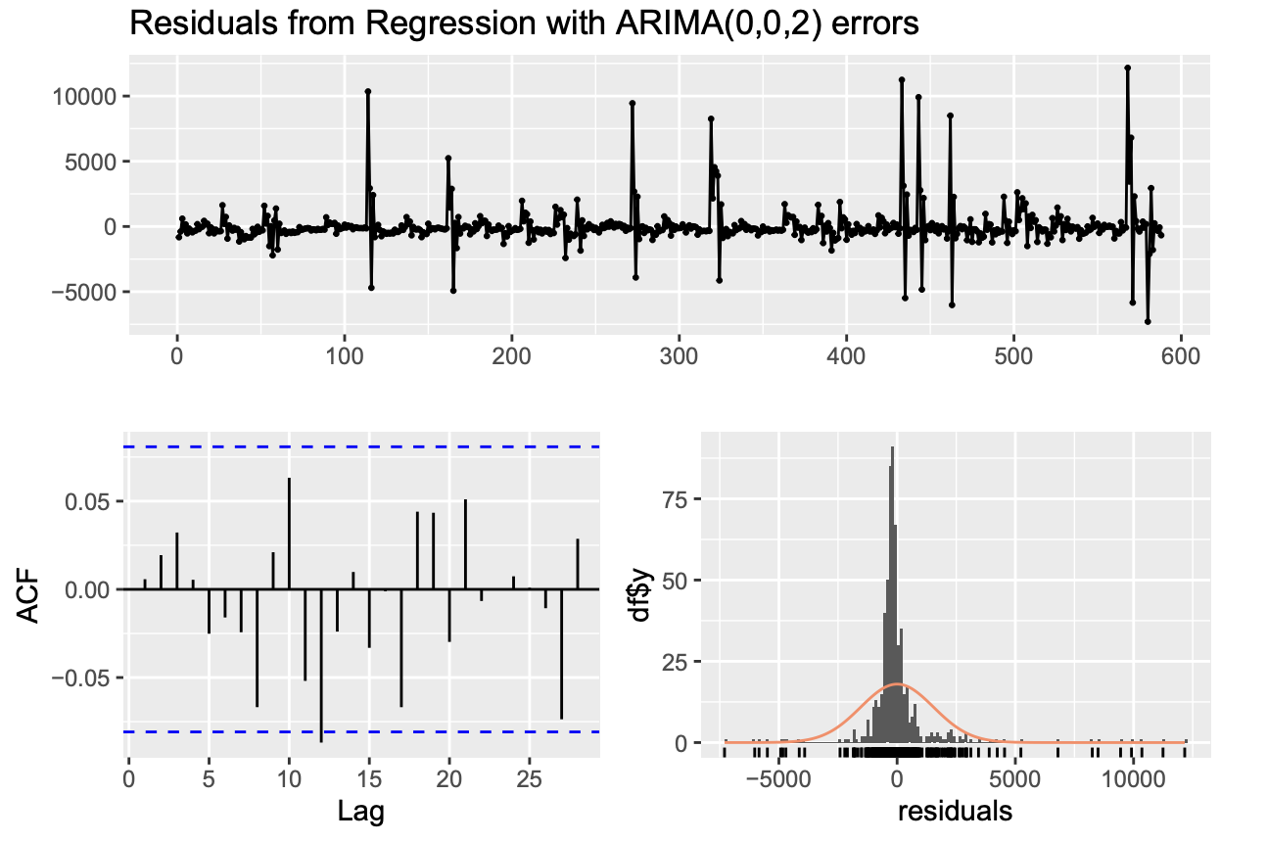
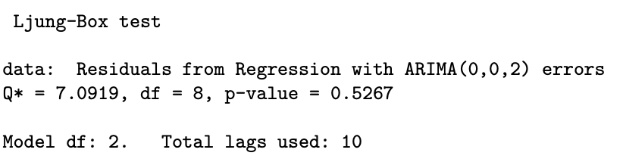
SARIMAX with additional variables
Edited slide with new code changes
We are using DIFF_TOTAL_DOLLARS of the merged dataset to be our external regressor and onediffvalue to be out target variable. The auto.arima() chooses the model to be a (0,0,2) model.

Slide 16
Prophet
Seasonality Handling: For our dataset, Prophet's flexibility allowed us to capture weekly trends effectively, which is crucial given our data’s weekly business cycle characteristics.
Data Preparation:
Column Selection and Renaming: We prepped our dataset by selecting and renaming columns to 'ds' and 'y', aligning with Prophet's format requirements.
Date Formatting: Ensured the 'ds' column was correctly formatted as dates, essential for accurate time series forecasting with Prophet.
Model Building and Parameters:
Seasonality Adjustments: Enabled weekly seasonality based on our data’s patterns, disregarding daily fluctuations to better align with observed trends.
Reasoning: Chose these settings based on initial data insights, focusing on weekly influences which were most relevant to our analysis.
Forecasting:
Future Dataframe: Created a future timeframe matching our test set to project forecasts.
Prediction Analysis: Matched forecasts against test data, evaluating how well Prophet captured future trends.
Performance Evaluation:
MSPE: Calculated Mean Squared Prediction Error to measure forecast accuracy.
Implications: Used MSPE to evaluate and discuss the model's effectiveness in predicting real-world outcomes, focusing on areas of strength and needed improvements.

Slide 17
MSPE for all models
Note: Results from the new code changes
The MSPE values are calculated for the SARIMA and SARIMAX and Prophet models on the test dataset, providing a measure of the models’ predictive performance.
MSPE for SARIMA model without additional variable: 7558075.43500495
MSPE for SARIMAX model with additional variable:7556795.88658626
Mean Squared Prediction Error (MSPE) for Prophet: 6611852.07536799

Slide 18
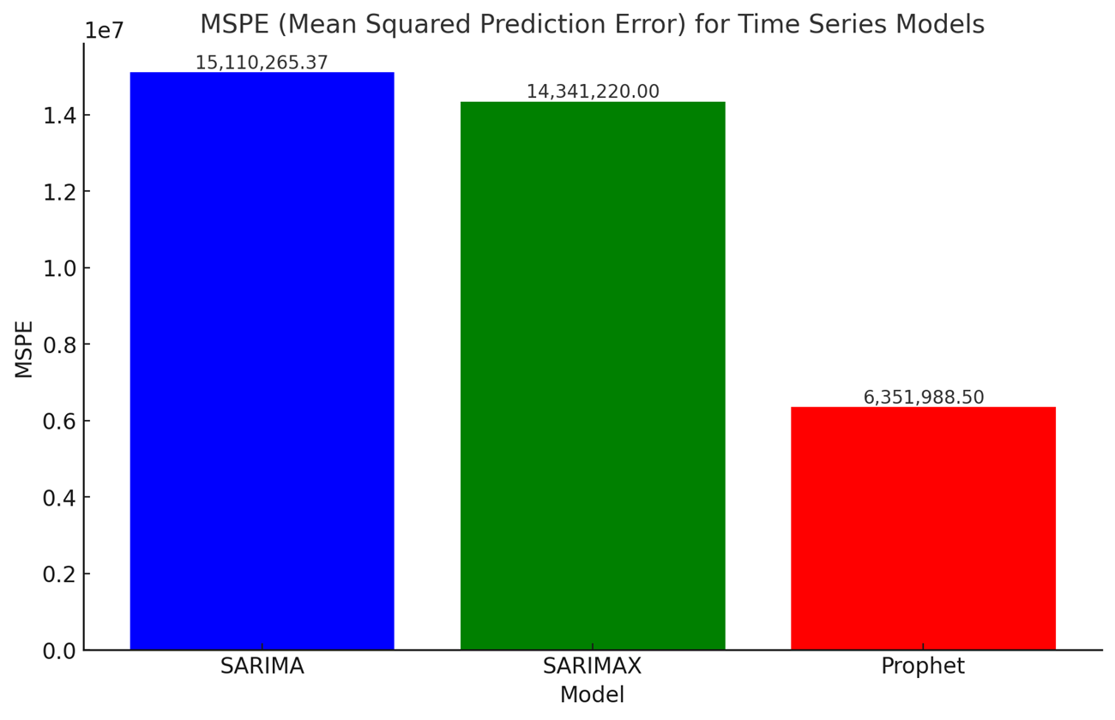
MSPE Results Summary
MSPE Overview: The Mean Squared Prediction Error (MSPE) quantifies the average of the squares of the errors between the forecasted and actual values.
Model Performance: Among the evaluated models, Prophet demonstrates superior predictive accuracy with an MSPE of 6,351,988.50, significantly lower than SARIMA's 15,110,265.37 and SARIMAX's 14,341,220, highlighting its effectiveness in forecasting Google Trends data.

Slide 19
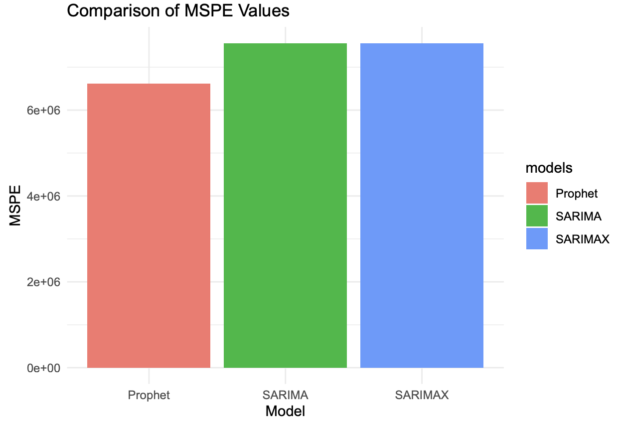
Compare MSPE’s for all 3 models:
Note: Results from the new code changes
Prophet model better than SARIMA and SARIMAX since it has the lowest MSPE as compared to the other 2 models

Slide 20
MSPE Results Summary
SARIMA: This model does not include external variables such as ad spending. The higher MSPE could be due to the model's inability to account for external influences that affect Google Trends. The Ljung-Box test suggests that there are still autocorrelations in the residuals, indicating that the model could be improved.
SARIMAX: Including ad spending as an external regressor improved the model's MSPE slightly compared to the SARIMA model. The Ljung-Box test p-value for the SARIMAX residuals is greater than 0.05, suggesting that there's no significant autocorrelation left in the residuals, which is a good sign. However, it still does not perform as well as the Prophet model, possibly due to how each model handles seasonality or trend components differently.
Prophet: Prophet automatically detects changepoints in the data and can accommodate non-linear trends with its piecewise linear or logistic growth curve model. It also handles seasonality and holidays, which might explain its better performance if such events significantly impact Google Trends data. The lower MSPE value suggests that Prophet was able to capture the underlying patterns in the data more effectively.
The Prophet model has the lowest MSPE, which suggests it is the most accurate at predicting the test set out of the three models.
Complexity of Models: SARIMA and SARIMAX models require manual selection of AR, MA, and differencing terms, which can be complex and may not capture all aspects of the data, especially when there are non-linear trends or seasonality changes. Prophet, on the other hand, makes it easier to model non-linear trends and automatically selects seasonal components, which can often lead to better performance without the need for intricate parameter tuning.

Slide 21
Questions??

Slide 22
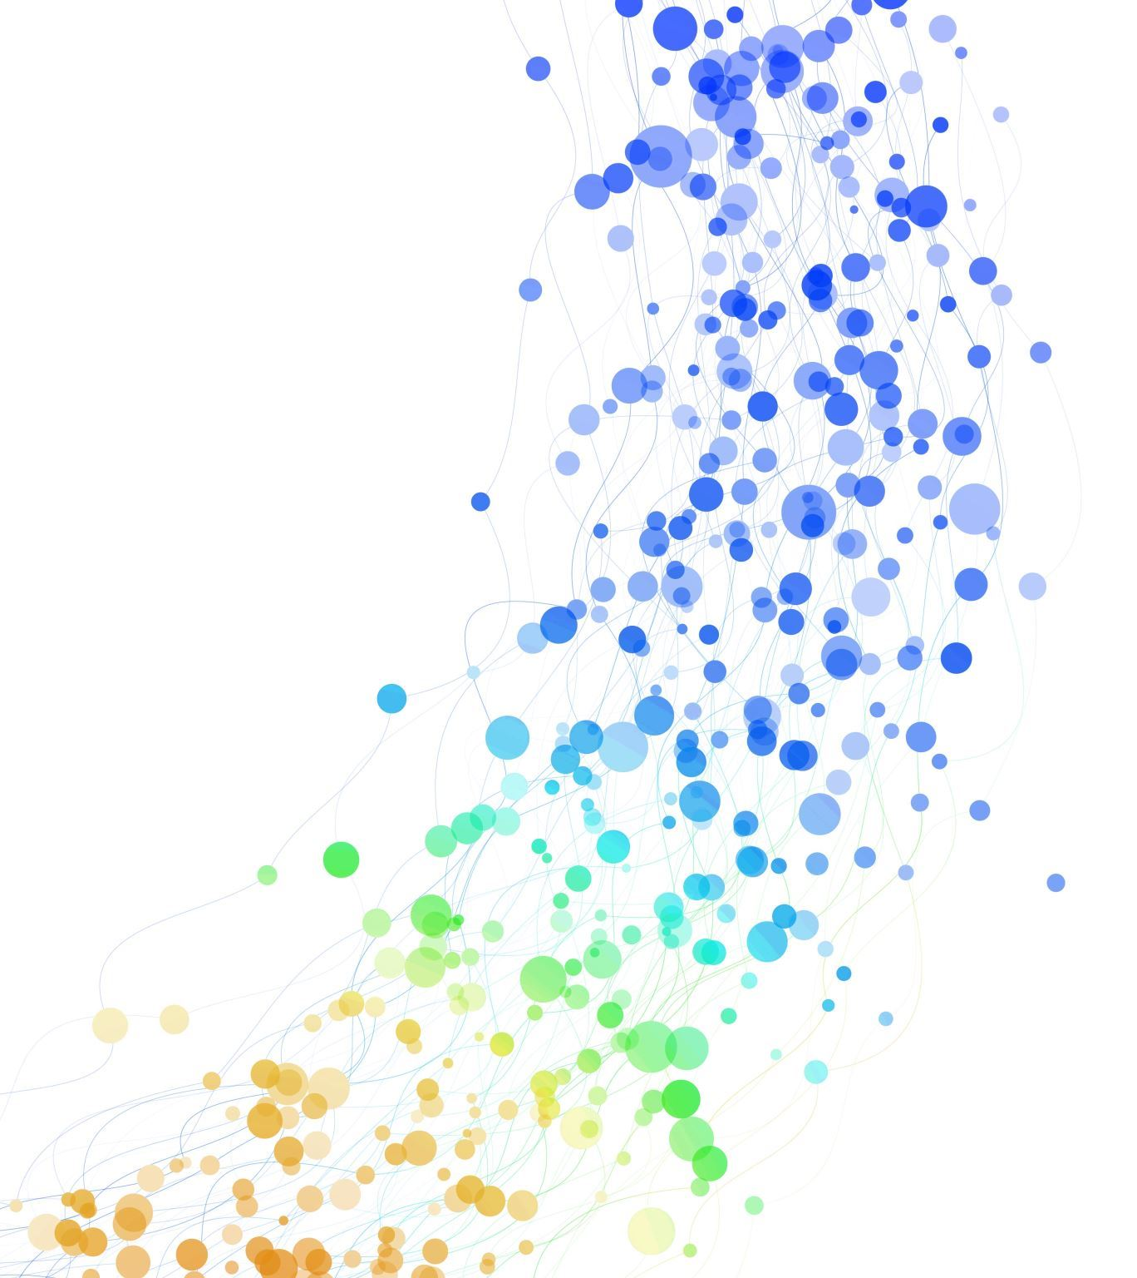
Thankyou!!

